Slide 1
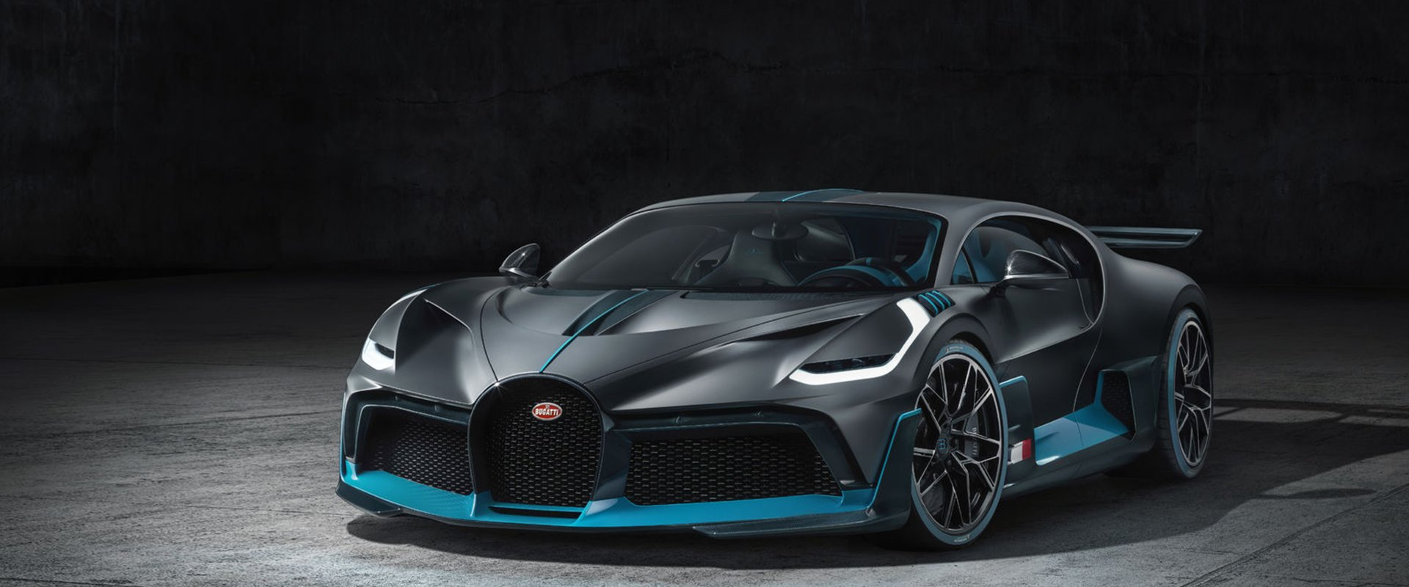
What factors may cause the car fuel consumption?
Notes:
My research question is about the factors cause the fuel consumption for a specific car. It is meaningless if we compare the consumption of a racecar and a normal car.

Slide 2






Datasets
Distance
Speed
Temperature
AC
Gas Type
Weather
Notes:
At the beginning, I came up with some factors that may affect the fuel consumption. Fortunately, I found a dataset on Kaggle and that dataset contained almost all the information and factors in my mind.
The data was recorded for a specific car. Its owner recorded the data of distance, average speed, temperature inside and outside of the car, the AC was turned on or off, the gas type refilled, and the weather condition.
This dataset was great because all the data were numbers, so it was easy for me to use the data directly.

Slide 3
Regression
Notes:
First, I used the Regression in Excel to find is there any factor can affect the consumption.

Slide 4
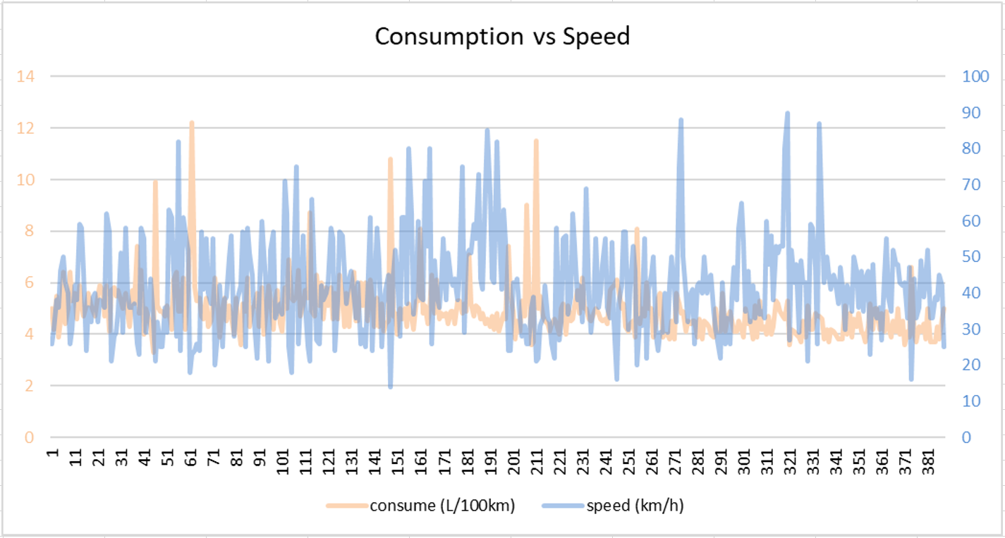
Notes:
As you can see, it was not that clear and meaningful for my question.
Then, I found that most of the factors could not affect the consumption obviously, except the gas type.

Slide 5
Regression
Notes:
So the regression didn’t work that well.

Slide 6
Clean Up & Analyze the Data
Notes:
So, I cleared up the gas type and related data and analyzed them. I calculated the total distance between each refill, and I got the consumption per refill with different gas types.
I rearranged the new data and got this chart.

Slide 7
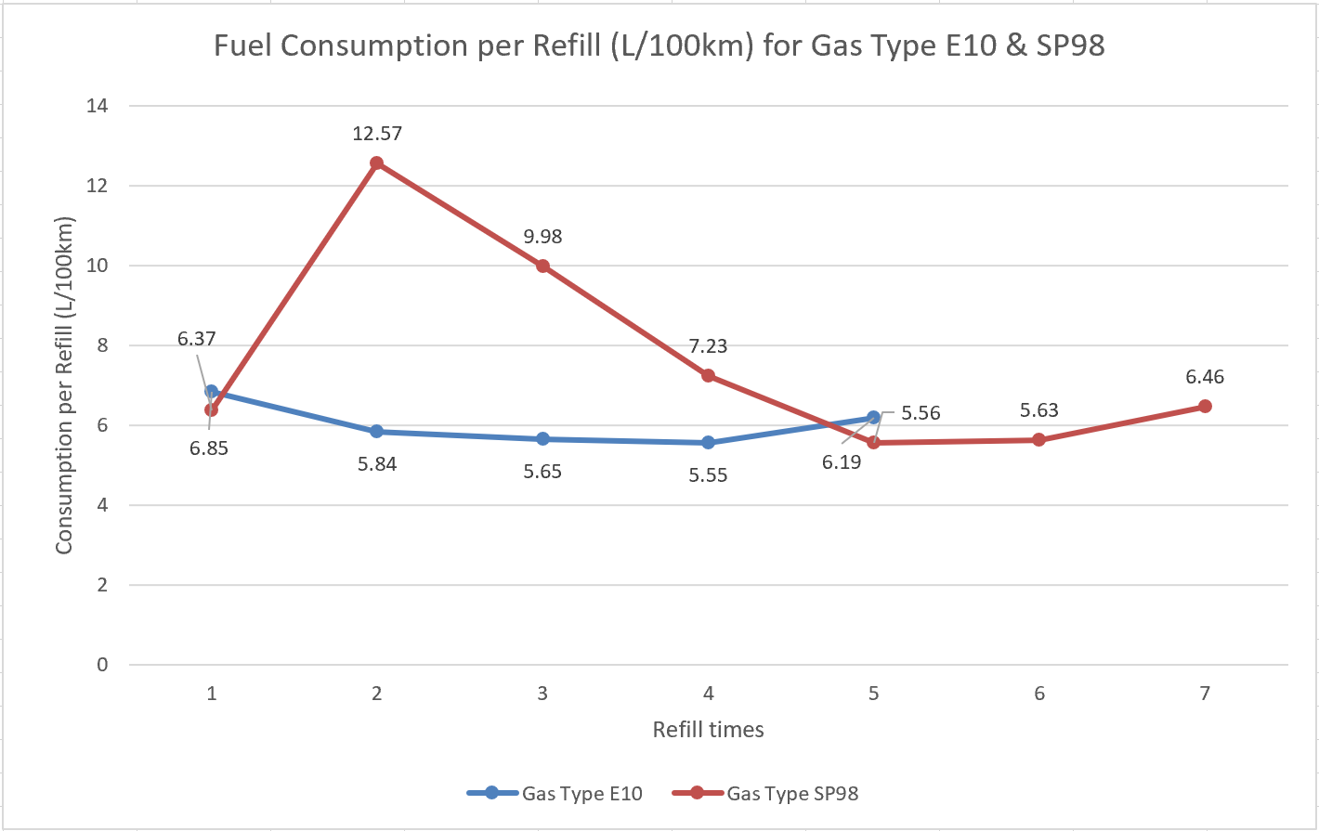
Notes:
As you can see, the consumption of SP98 was higher than E10.

Slide 8
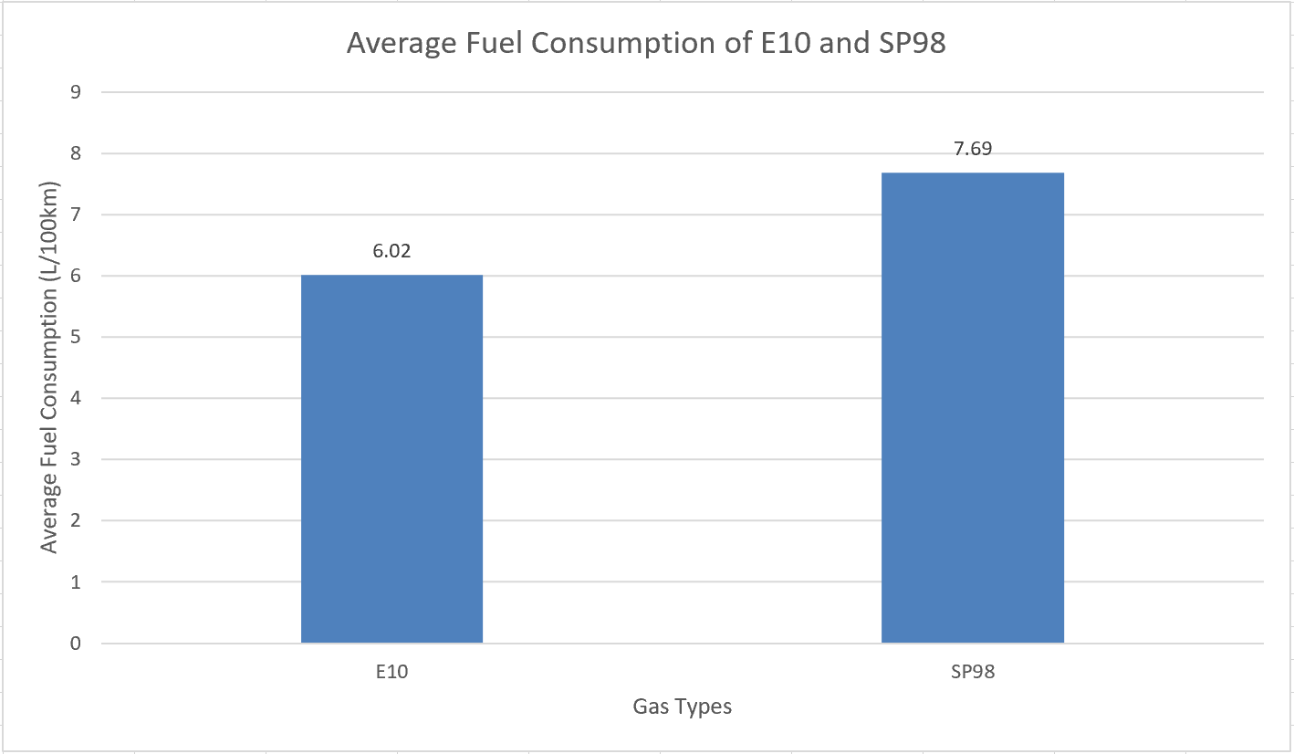
Notes:
Then, I calculated the average consumption values of SP98 and E10, and I got this table. The average fuel consumption of E10 was 6.02L/100km and the average fuel consumption of SP98 was 7.69L/100km. The SP98 had higher fuel consumption than E10 did.
So, the solution here is to fill more E10 gas if you want a lower fuel consumption and save money on the gas. And the research solution is that the gas type causes the fuel consumption (for the same car). Most people may believe that the AC and speed or the weather may cause the fuel consumption, but the truth is the gas type does.

Slide 9
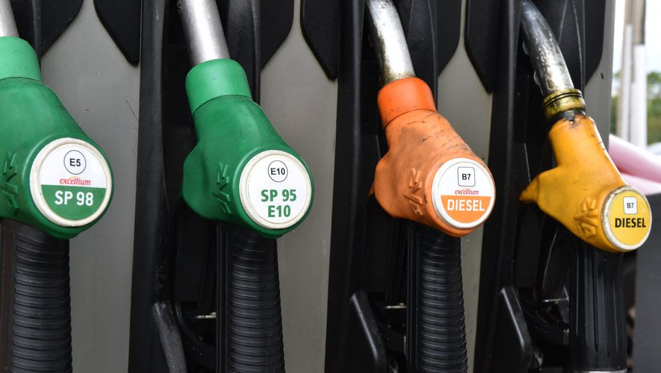
Gas Types
Notes:
SP98 - Unleaded & High Quality Fuel
E10 – Unleaded & Ethanol-based Fuel
It contains up to 10% ethanol. So the E10 is not only a low consumption but a cleaner gas.
The answer of this research question can help you guys to save money on gas, and use the cleaner gas at the same time.

Slide 10
References
https://www.bugatti.com/media/news/2019/coachbuilding-bugatti/
https://www.iconsdb.com/black-icons/road-2-icon.html
https://www.visualpharm.com/free-icons/speed-595b40b85ba036ed117db26e
https://www.shareicon.net/fahrenheit-mercury-tools-and-utensils-temperature-thermometer-degrees-celsius-758469
https://www.londonhousehotels.com/room/double-room-lower-ground/air-con/
https://www.iconsdb.com/black-icons/gas-pump-icon.html
https://www.flaticon.com/free-icon/cloudy_116690
https://www.twipu.com/ethanolfacts/tweet/1126087989095010305
https://www.kaggle.com/anderas/car-consume

